Slide 1
Ibis Solution for EMF measurements

Slide 2
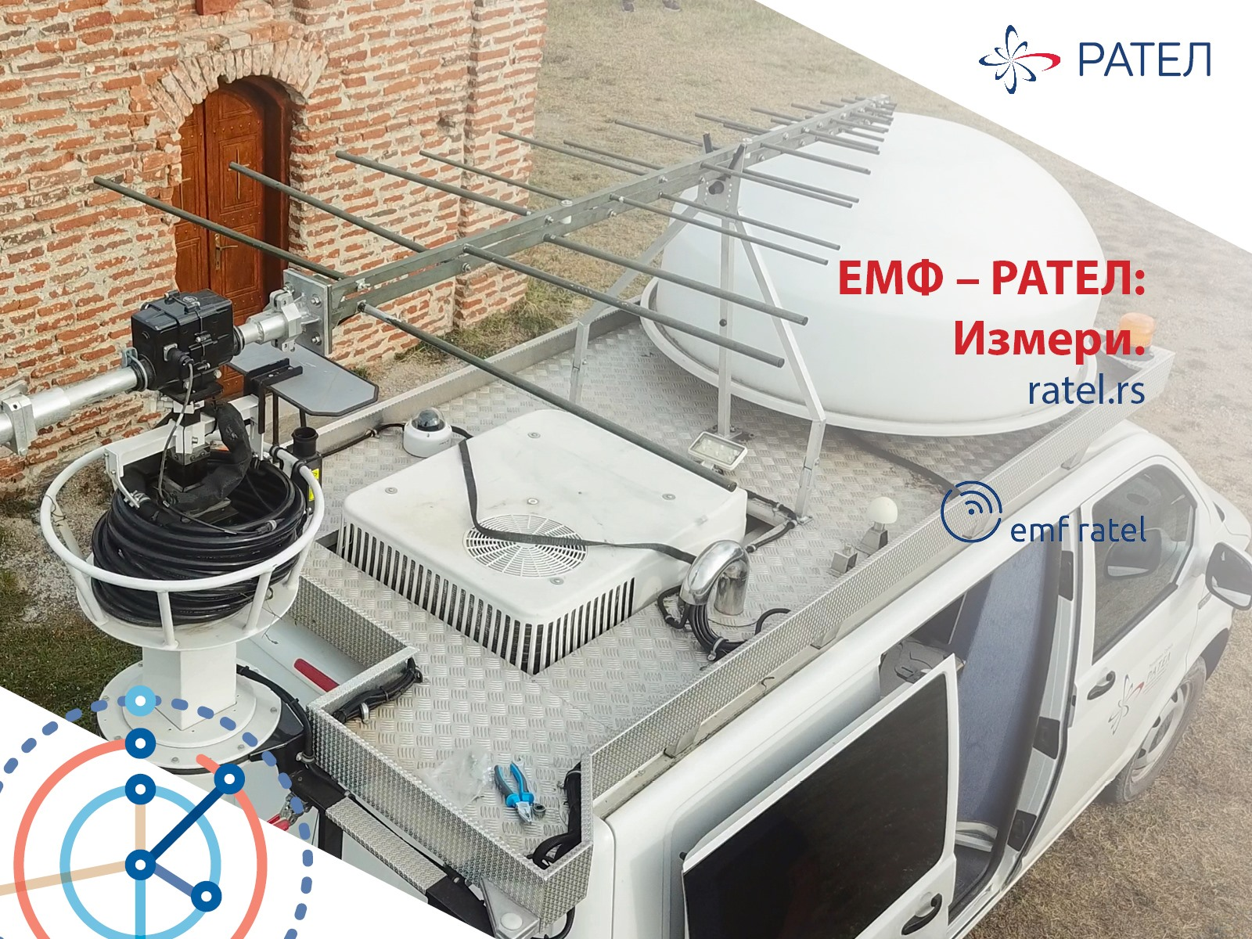
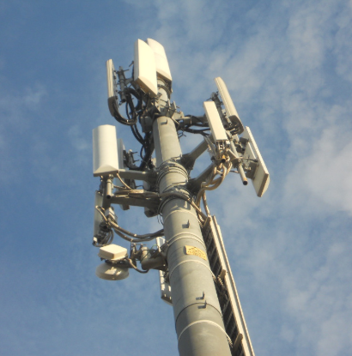
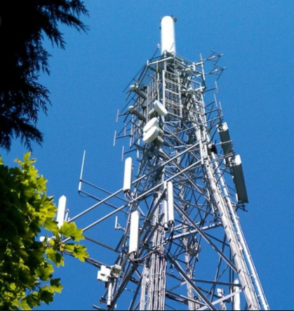
ELECTROMAGNETIC FIELD INFLUENCE
According to WHO electromagnetic fields represent one of the most common and fastest growing environmental influences, about which anxiety and speculation are spreading.
All populations are now exposed to varying degrees of EMF, and the levels will continue to increase as technology advances.
Measurement of EMF radiation applications
Regulators / Communications Utilities Broadcasting Industry
Environmental
Protection Agency
The EM field testing and measurements are extremely important, considering the possible impact of the EM field on the human organism.
2
www.ibis-instruments.com

Slide 3
Why EMF monitoring?
A permanent monitoring system allows on-going measurement of the emission levels of any source of electromagnetic radiation (mobile telephone antennas, WiFi, high-voltage power lines, etc.) and verification that they meet the safety standards established by the competent authorities and regulations in each country.
The measurements can be published via the Internet to the different stakeholder communities
The MonitEM family of produtcs is a set of devices for continuous monitoring of electromagnetic fields. A single concept resulting in several models to meet specific monitoring needs, both indoor and outdoor. Discover the EMF monitor that best suits your application.
EMF monitoring concepts:
Continuous monitoring
Indoor monitoring
Electromagnetic maps
3
www.ibis-instruments.com

Slide 4
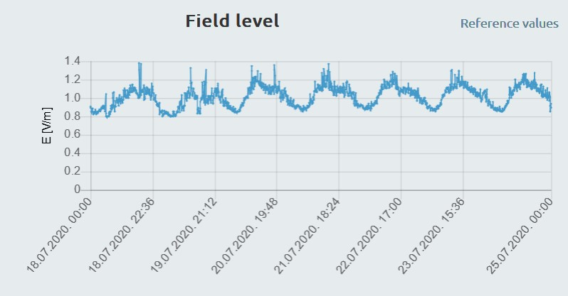
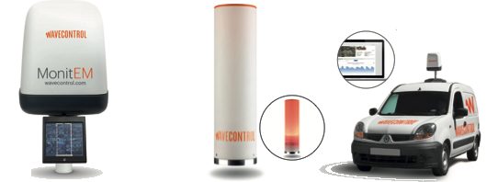
EMF monitoring concepts
Continuous monitoring:
Broadband measurements Up to 3 kHz in LF and 60 GHz in HF
IP 66 protection
Complies with ITU-T K.83 recommendation
Indoor monitoring:
Special version of the MonitEM designed for laboratories, development and production centres, etc.
Realtime, audible and visual alarms
AC supply and ethernet communication
Electromagnetic maps:
Large-area outdoor coverage
Highly effective visual communication tool
Supplements SMP2 and MonitEM

Slide 5
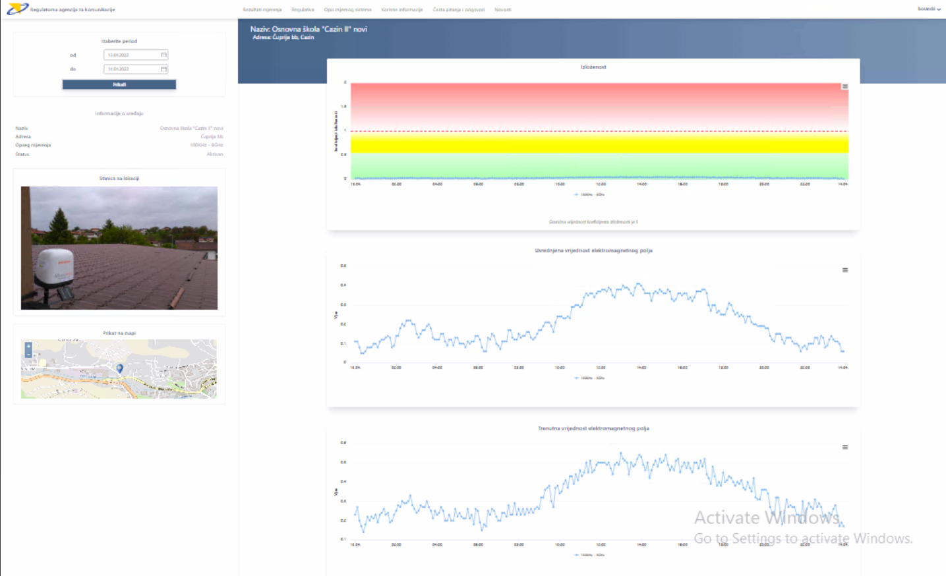
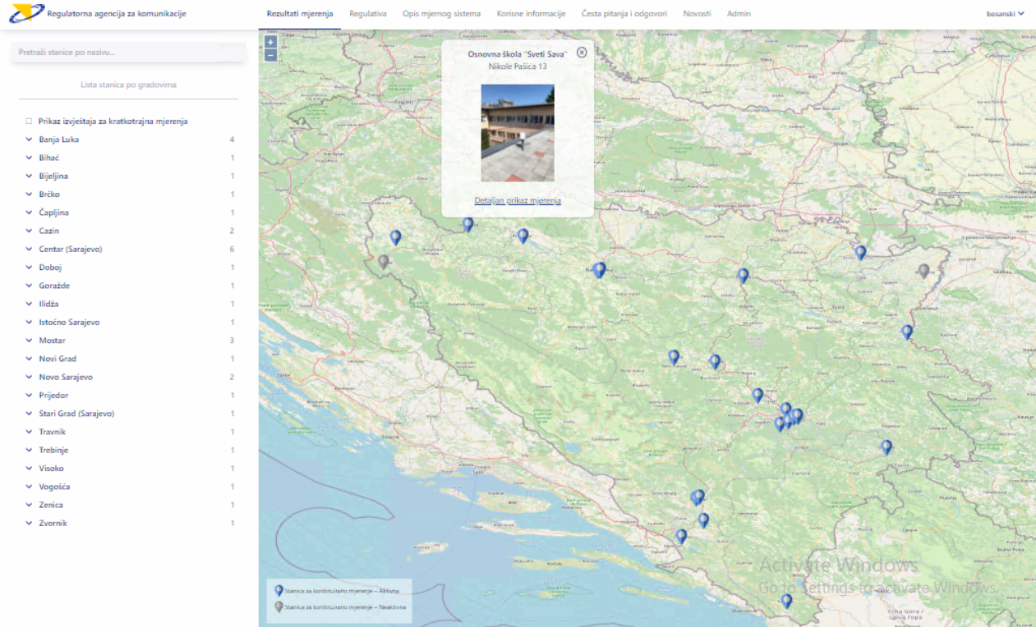
EMF monitoring portal
Display of installed stations on the map and filtering
Education part (EM field, EMF field testing, Regulation)
Administrative part of portal
News

Slide 6
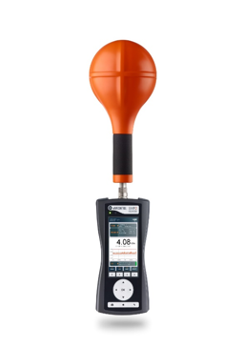
Field measurements
Field measurements are commonly performed to verify that limits are not exceeded.
Measuring devices are available for:
low or high frequency applications
broadband test for detailed assessment of EMF
Broadband EMF meter
Main features:
Broadband measurements DC - 60 GHz
Spectrum analysis DC - 400 kHz (Real-time FFT)
Real-time comparison in % with the selected limits
Measurements conforming to ICNIRP
Applications:
Broadcasting, telecommunications and cellular radio
Radar, directional radio and satellite transmitter equipment
Power supply
Electric railroads
Medicine
6
www.ibis-instruments.com

Slide 7
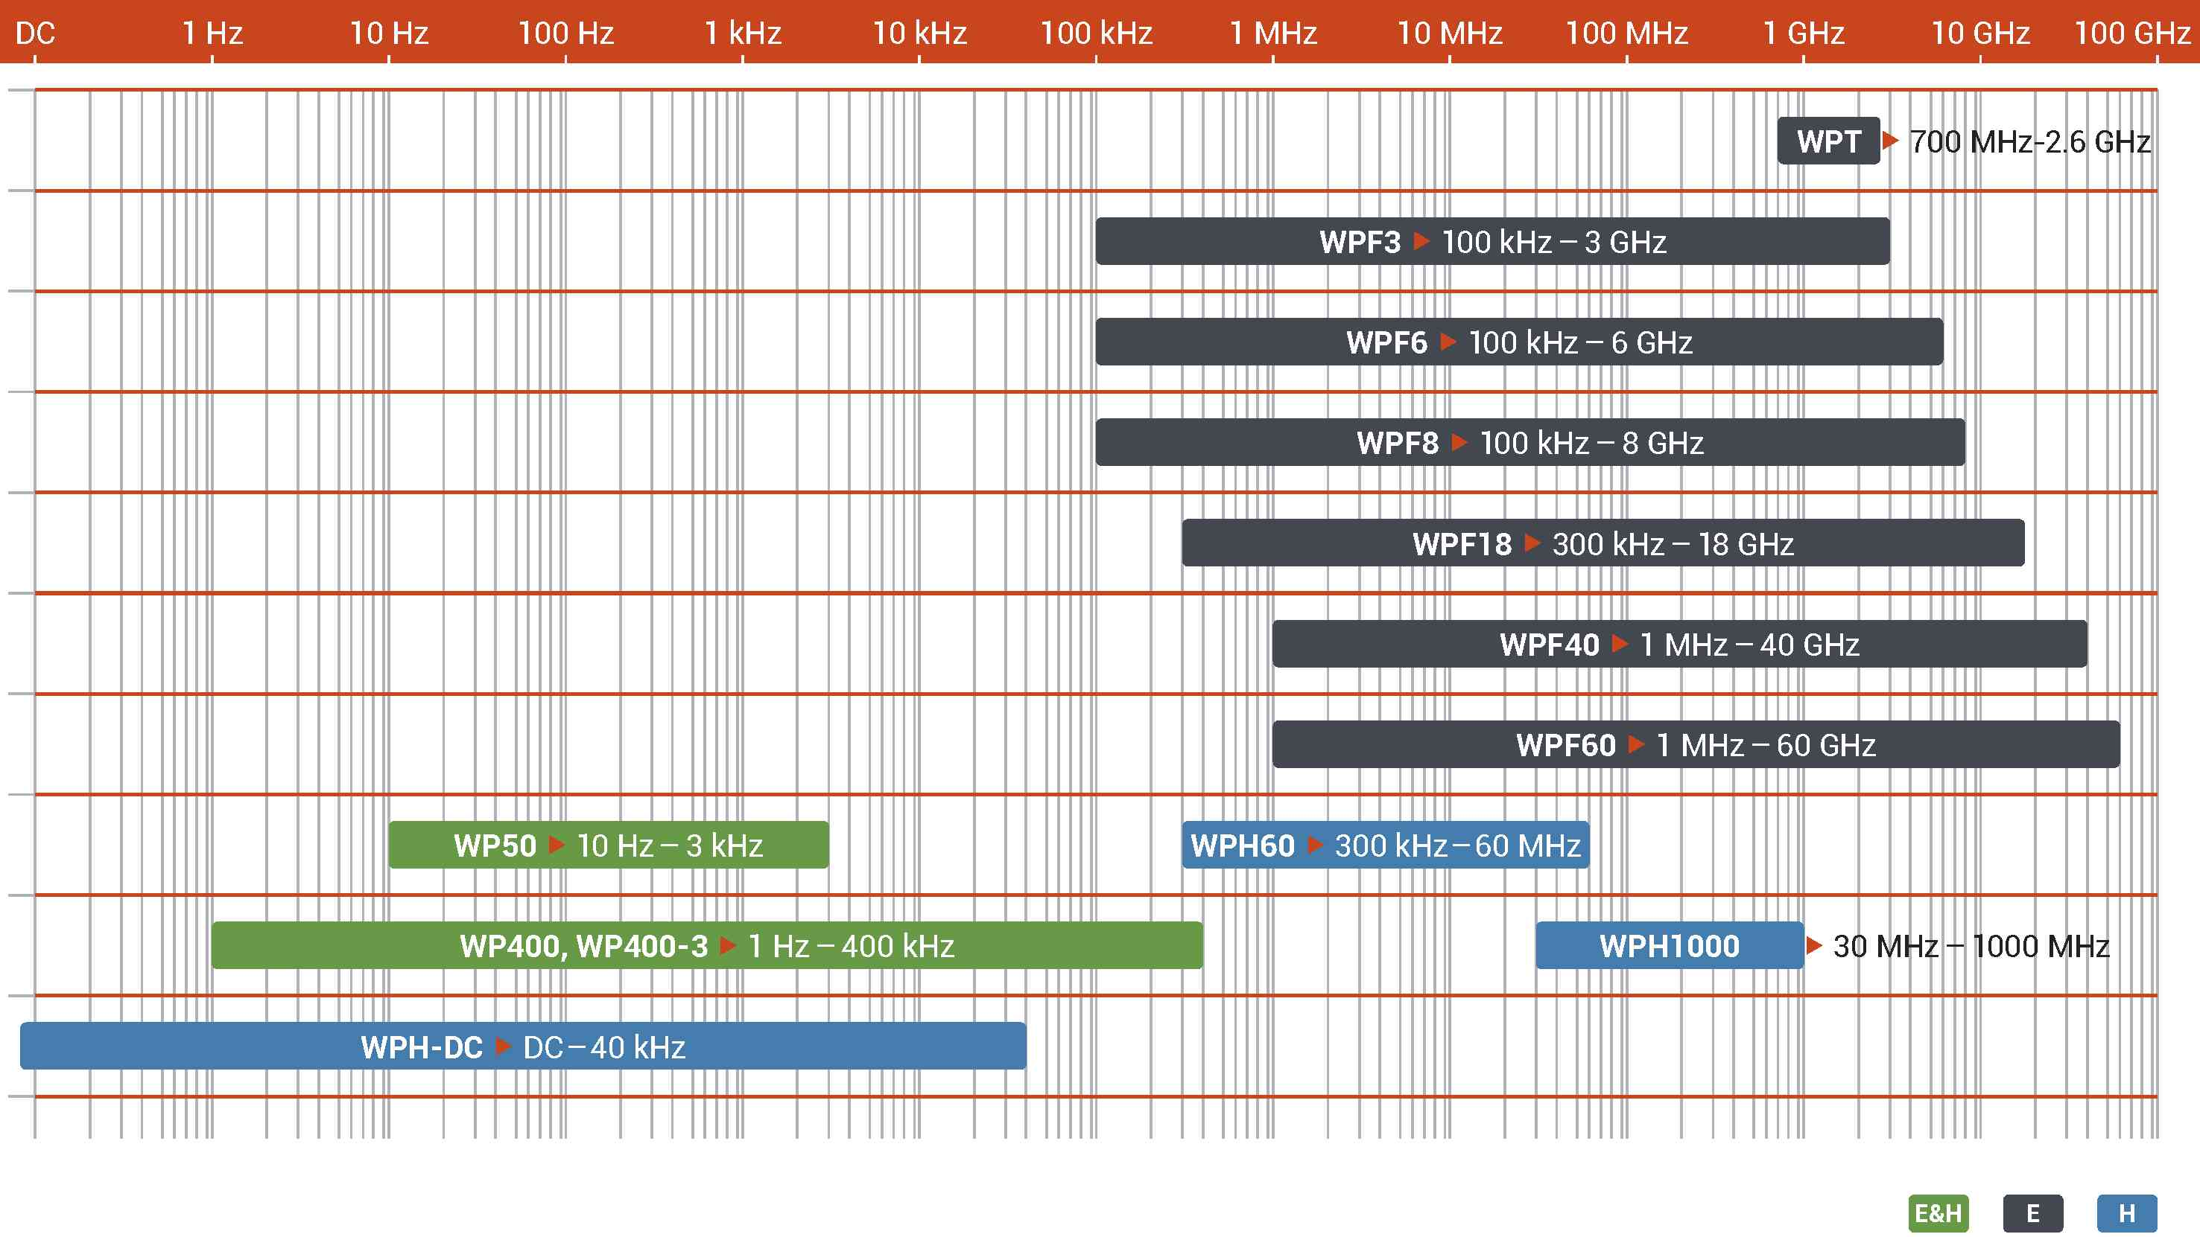
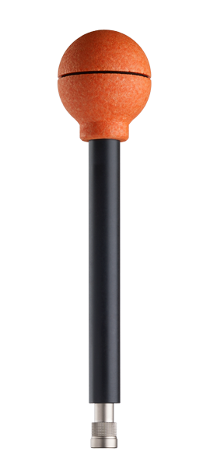
Measurement probes
Wavecontol offers a wide range of probes compatible with both handheld and monitoring devices.

Slide 8
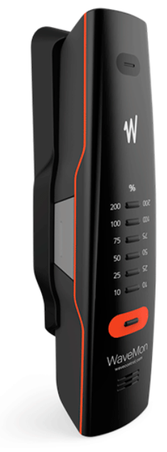
Personal safety
The WaveMon Family consists of RF and LF Personal Monitors for human exposure to EMF.
Protection of employees from health risks due to EMF in the workplace became one of very important thing today.
The main aim is to prevent employees from being exposed to high field strengths for longer periods of time.
Main features:
For general public and occupational exposure
Data collecting and Reporting
Geolocation of measurements
With user definable trigger threshold
Applications:
Broadcasting, telecommunications and cellular radio
Radar, directional radio and satellite transmitter equipment
8
www.ibis-instruments.com

Slide 9
REFERENCES
GOVERNMENT
CSPs
UTILITTIES
SDI
9
9
www.ibis-instruments.com
www.ibis-instruments.com

Slide 10
IBIS INSTRUMENTS BANJA LUKA
Jovana Dučića 37, 78000 Banja Luka,
Bosnia and Herzegovina Tel: +387 51 223 840 Fax: +387 51 223 841 E-mail: office-bl@ibis-instruments.com Web: www.ibis-instruments.com
IBIS INSTRUMENTS DOOEL
Import - Export Skopje
Veljko Vlahović 1-2/2, 1000 Skopje, Macedonia Tel: +389 2 321 5700 Fax: +389 2 321 5700 E-mail: info@ibis-instruments.mk Web: www.ibis-instruments.com/mk
IBIS INSTRUMENTS BELGRADE
Tošin bunar 272, 11070 Belgrade, Serbia
Tel: +381 11 715 22 00
Fax: +381 11 715 22 01
E-mail: info@ibis-instruments.com
Web: www.ibis-instruments.com
IBIS INSTRUMENTS d.o.o.
Ulica Jožeta Jame 14
1210 Ljubljana – Šentvid,
Slovenia
Tel: +386 31 647 600
E-mail: slovenija@ibis-instruments.com

