Slide 1
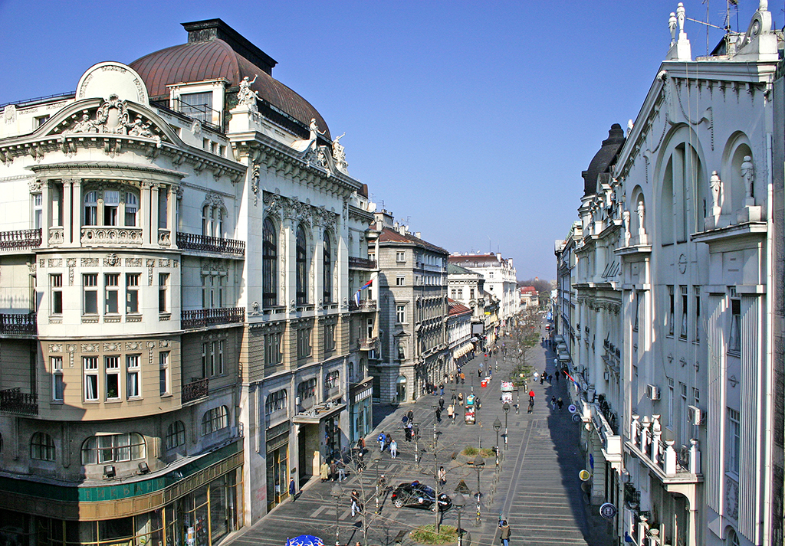
C O N F E R E N C E T O P I C S
ATOMIC COLLISION PROCESSES 1.1. Electron and Photon Interactions with Atomic Particles 1.2. Heavy Particle Collisions 1.3. Swarms and Transport Phenomena
2. PARTICLE AND LASER BEAM INTERACTION WITH SOLIDS
2.1. Atomic Collisions in Solids 2.2. Sputtering and Deposition 2.3. Laser and Plasma Interaction with Surfaces
3. LOW TEMPERATURE PLASMAS 3.1. Plasma Spectroscopy and Other Diagnostic Methods 3.2. Gas Discharges 3.3. Plasma Applications and Devices
4. GENERAL PLASMAS 4.1. Fusion Plasmas 4.2. Astrophysical Plasmas 4.3. Collective Phenomena
P L E N A R Y l e c t u r e r s
S C I E N T I F I C C O M M I T T E E
Xiao-Min Tong (Japan)
Stephan Schlemmer (Germany)
Alicja Domarcka (France)
Carla Faria (United Kingdom)
Gerhard G. Paulus (Germany)
Himadri Chakraborty (USA)
Jan van Dijk (Netherlands)
Satoshi Hamaguchi (Japan)
Paola Marziani (Italy)
Andreja Gomboc (Slovenia)
Luca Volpe (Spain)
J. Cvetić, Serbia (Co-chair), Serbia
B. Obradović (Co-chair), Serbia
A. Antoniou, Greece
J. Burgdörfer, Austria
M. Ćosić, Serbia
V. Guerra, Portugal
M. Ivković, Serbia
J. Kovačević-Dojčinović, Serbia
K. Kutasi, Hungary
I. Mančev, Serbia
D. Marić, Serbia
N. J. Mason, UK
A. Milosavljević, France
V. Milosavljević, Serbia
D. Miloševic, BH
K. Mima, Japan
L. Nahon, France
G. Poparić, Serbia
I. Radović, Serbia
P. Ranitovic, Serbia
P. Rousseau, France
I. Savić, Serbia
Y. Serruys, France
N. Simonović, Serbia
V. Srećković, Serbia
M. Škorić, Japan
S. Tošić, Serbia
M. Trtica, Serbia
R. White, Australia
www.spig2024.ipb.ac.rs
spig2024@ipb.ac.rs
T O P I C A L l e c t u r e r s
O R G A N I Z I N G C O M M I T T E E
Nuno Pinhão (Portugal)
Ugo Jacovella (France)
Helgi Hrodmarsson (France)
Marija Gorjanc (Slovenia)
Milan Radović (Switzerland)
Andrey Kaziev (Russia)
Peter Papp (Slovakia)
Violeta Lazić (Italy)
Mirjana Kostić (Serbia)
Miran Mozetič (Slovenia
Nevena Puač (Serbia)
Peter Hartmann (Hungary)
Claudia Lazzaroni (France)
Paul Maguire (United Kingdom)
M. Kuzmanović (Chair)
M. Ristić (Co-secretary)
B. Stankov (Co-secretary)
N. Konjević
N. Cvetanović
D. Ranković
M. Milovanović
M. Marković
A. Šajić
I. Taparić
W O R K S H O P S
2nd Workshop on Swarm Physics and Gaseous Dielectrics
LIBS4Fusion Workshop

